Slide 1
Unit 210: Understand how to communicate with others within building services engineering
Construction team members

Slide 2
Construction team members
Sub-contractors
They enter into a contract with the main building contractor to carry out a specific or specialist area of work. These will usually include:
bricklayer
joiner
plasterer
tiler
electrician
H&V fitter
gas fitter
decorator
ground workers.

Slide 3
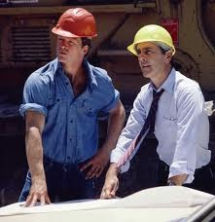
Construction team members
Site supervisor
Also referred to as the construction manager, the site supervisor is the building contractor’s main representative on site and is responsible for the day to day running of the site, including budgets, hiring, deliveries and construction duties.

Slide 4

Construction team members
Trade supervisor
Each of the different trades will have their own supervisor, who is responsible for the running of their part of the contract.
Allocation of duties.
Coordination with other trades.
Attendance records.
Explaining and enforcing regulations.
Overseeing workforce.
Resolving problems and grievances.

Slide 5
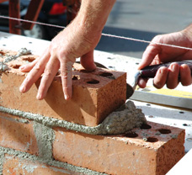
Construction team members
Bricklayer
They will construct the building to the architect’s specification using bricks, blocks and stone.

Slide 6
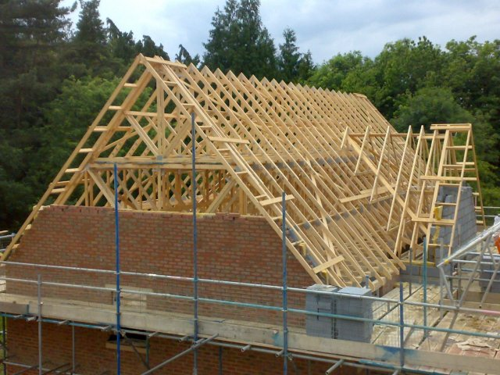
Construction team members
Joiner
Also known as carpenters, during first fix, they will install doorways, window frames, joists and trusses.
During second fix, they will install doors, skirting and architraves.

Slide 7
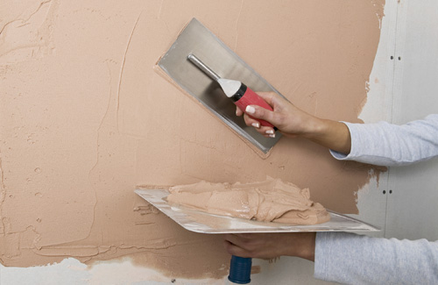
Construction team members
Plasterer
They will carry out wall and ceiling finishes, dry lining and rendering, using modern and traditional methods.

Slide 8
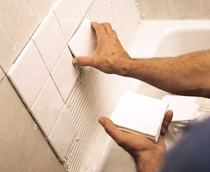
Construction team members
Tiler
They will tile floors and walls in properties.
Specialists may be needed to tile swimming pools and wet rooms.

Slide 9
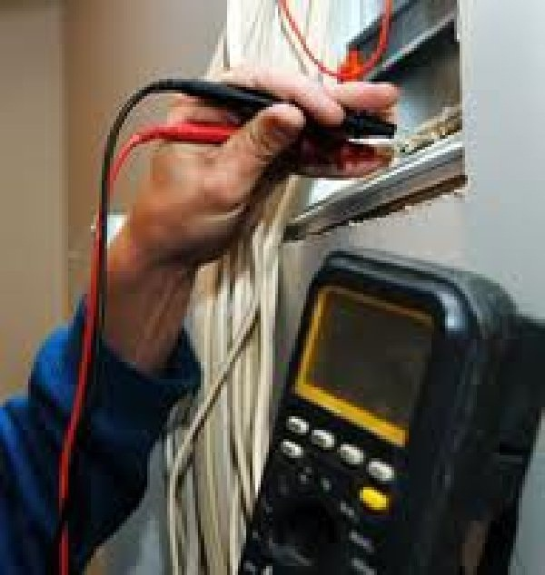
Construction team members
Electrician
The electrician installs and tests electrical installations for lights, sockets, fire alarms and intruder alarms.
During first fix, they will install cable, conduit and trunking.
During second fix, they will install light fittings and electrical accessories.

Slide 10
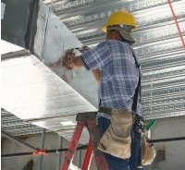
Construction team members
Heating and ventilation engineer
A heating, ventilation and air conditioning, or HVAC, engineer installs heating and cooling systems for homes and commercial buildings.
This will generally involve installing pipework and ducting during first fix, and appliances during the second fix.

Slide 11
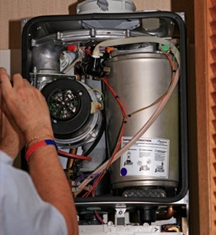
Construction team members
Gas fitter
They will install gas pipes and gas appliances.

Slide 12
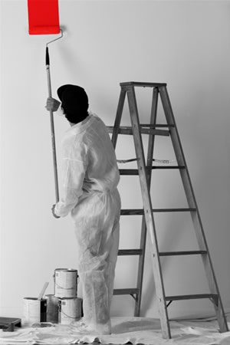
Construction team members
Decorator
Also referred to as painters, they will paint and wallpaper walls, ceilings and woodwork.

Slide 13
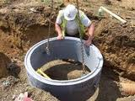
Construction team members
Ground worker
Sometimes referred to as general operatives or labourers, they will mix concrete, lay drains, offload materials and generally assist craft operatives.

Slide 14
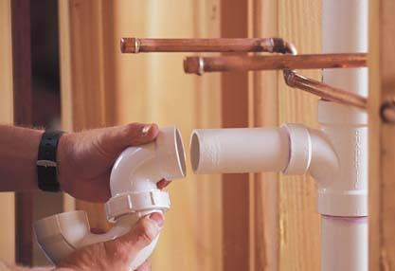
Construction team members
Plumber
They install hot and cold water, heating and gas, as well as soil and waste systems.
During first fix, they will install pipework and during second fix, they will install plumbing appliances.

Slide 15
Construction team members
Specialists
These can include scaffolders, glaziers, suspended ceiling installers, etc.

Slide 16
Unit 210: Understand how to communicate with others within building services engineering
The End

